Slide 1
LEAN Cultura e seus princípios
Diego Paris e Eduardo Cerejo
Julho de 2015

Slide 2
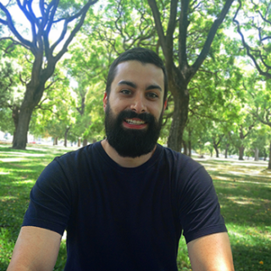

Quem somos?
Diego Paris
Coordenador de Projetos - UOL
Eduardo Cerejo
Gerente de Projetos - UOL

Slide 3
Histórico
2008
2011
2014
RUP
SCRUM
Kanban
Agile Coaching

Slide 4
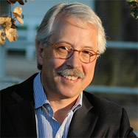
Por que trabalhamos assim?
“Trabalhamos no século XXI com modelos de négocio voltado à Internet, com gerenciamento de processos do século XX e tudo isso baseado nos princípios de gerenciamento do século XIX.”
Gary Hamel
Dr. Gary P. Hamel

Slide 5
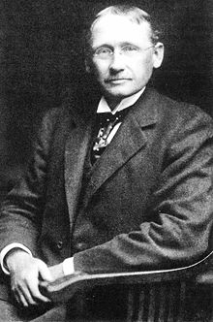
Metodologia de Taylor
Estrutura de empresa:
Departamentalização
Especialização
Foco na eficiência da produção
Padronização
Hierarquia
Frederick Taylor 1856-1915

Slide 6
Metodologia de Taylor
Estrutura de empresa:
Departamentalização
Especialização
Foco na eficiência da produção
Padronização
Hierarquia
Papel da gerência:
Controlar a jornada de trabalho
Supervisionar, não permitindo interrupções
Controlar o processo o processo de trabalho
Estabelecer o tempo necessário para concluir uma tarefa
Frederick Taylor 1856-1915

Slide 7
Metodologia de Taylor
Estrutura de empresa:
Departamentalização
Especialização
Foco na eficiência da produção
Padronização
Hierarquia
Papel da gerência:
Controlar a jornada de trabalho
Supervisionar, não permitindo interrupções
Controlar o processo o processo de trabalho
Estabelecer o tempo necessário para concluir uma tarefa
Papel do executor
Executar apenas a sua função
Não poderá perder seu tempo analisando o trabalho
O ritmo lento e a vadiação são inimigos da produção
Frederick Taylor 1856-1915

Slide 8

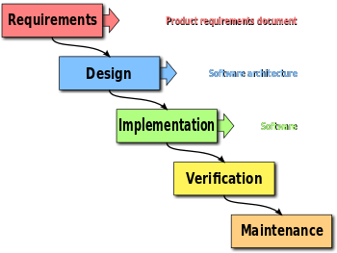
Modelo Cascata - Waterfall
1988 - Departamento de Defesa dos Estados Unidos.

Slide 9
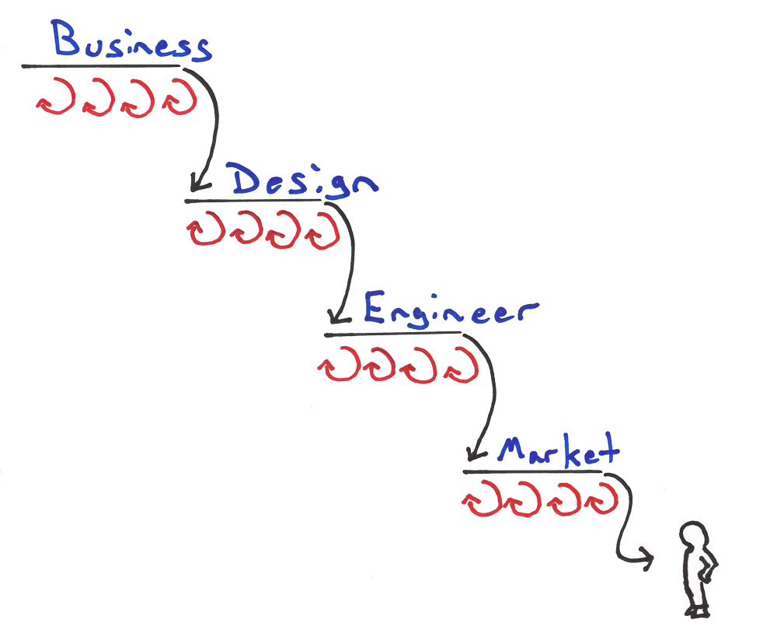
Modelo Cascata - Waterfall
?

Slide 10
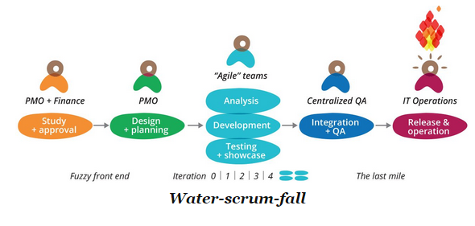
Water-scrum-fall

Slide 11










Tecnologia Disruptiva

Slide 12
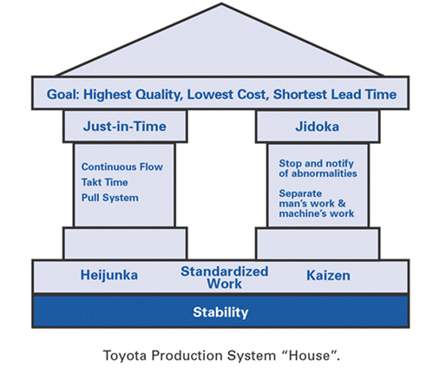
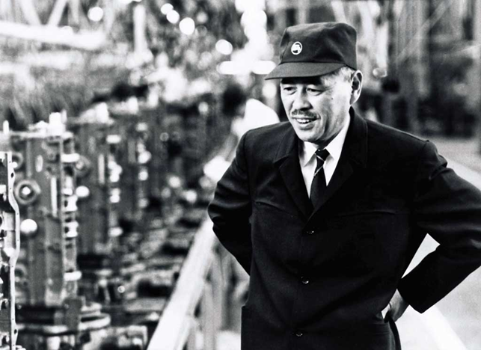
Modelo Toyota
Lean
Taiichi Ohno 1912 - 1990

Slide 13
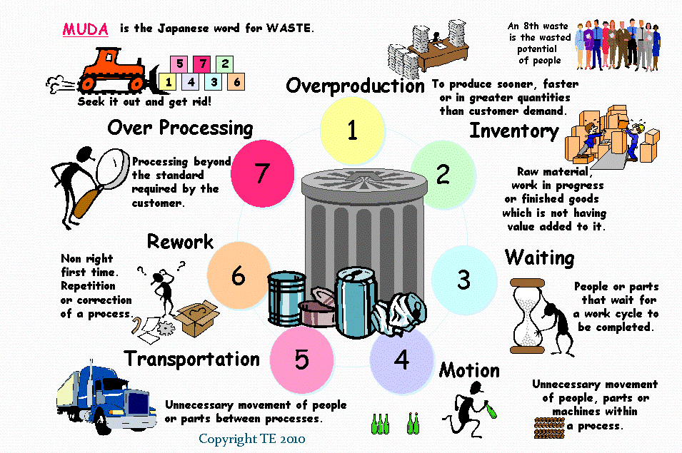
Os 7 Desperdícios

Slide 14
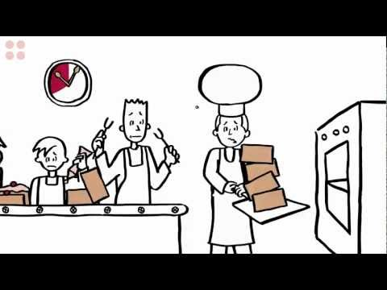

Slide 15
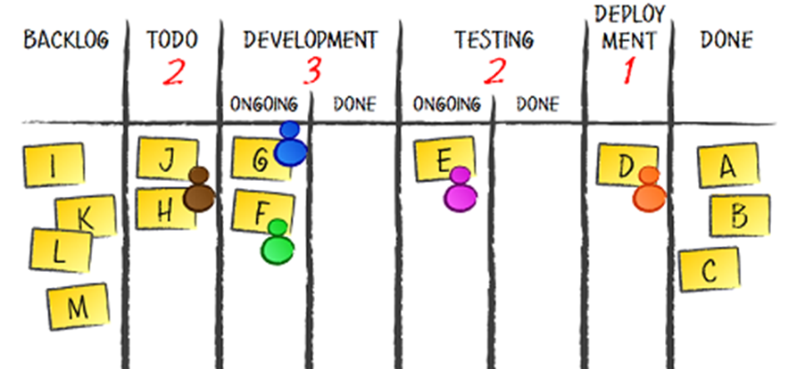
Exemplo de um kanban

Slide 16
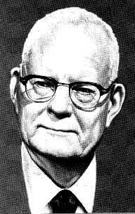
Princípios de Deming
Estrutura de empresa:
Eliminar barreiras entre departamentos
Foco na qualidade
Orientado a objetivo e visão do produto
Ambiente colaborativo
Educação e auto-aprimoramento
W. Edwards Deming

Slide 17
Princípios de Deming
Estrutura de empresa:
Eliminar barreiras entre departamentos
Foco na qualidade
Orientado a objetivo e visão do produto
Ambiente colaborativo
Educação e auto-aprimoramento
Papel da gerência:
Liderança e Coaching
Incentivar melhorias contínuas
Eliminar o medo
W. Edwards Deming

Slide 18
Princípios de Deming
Estrutura de empresa:
Eliminar barreiras entre departamentos
Foco na qualidade
Orientado a objetivo e visão do produto
Ambiente colaborativo
Educação e auto-aprimoramento
Papel da gerência:
Liderança e Coaching
Incentivar melhorias contínuas
Eliminar o medo
Papel do executor
Multifuncional
Visão de toda cadeia de produção
Responsável pelas melhorias de processo
W. Edwards Deming

Slide 19
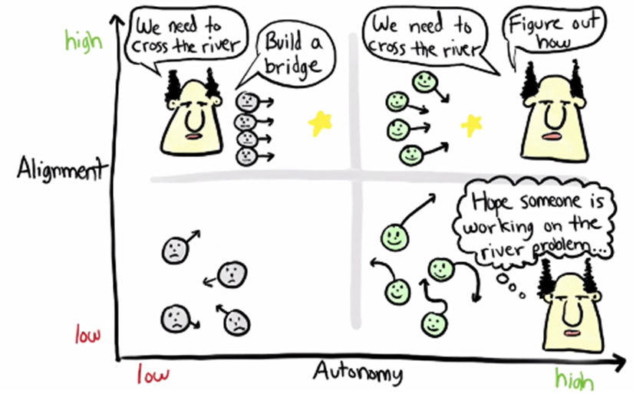
Liderança

Slide 20
Liderança

Slide 21
Liderança

Slide 22
Liderança

Slide 23
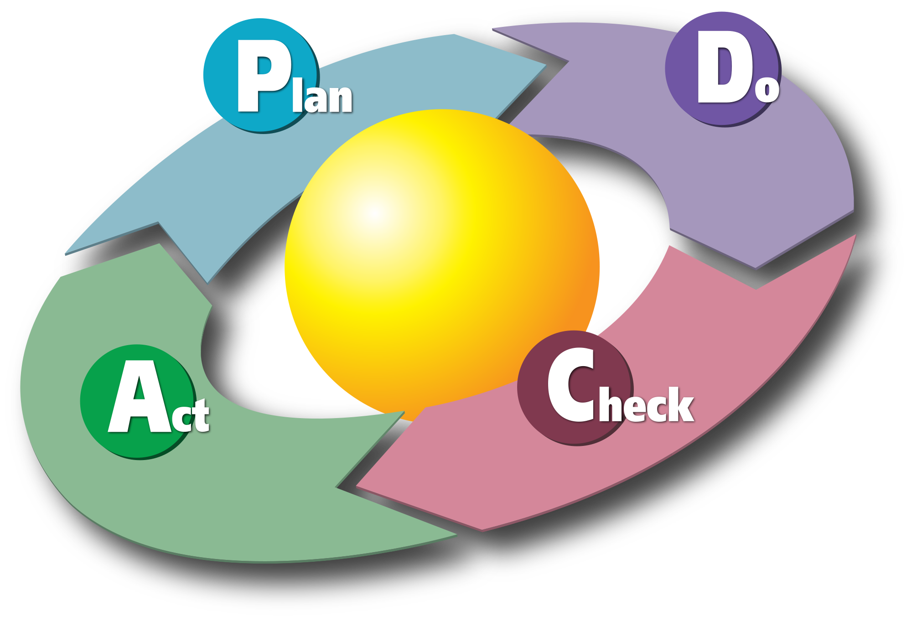
PDCA de Deming

Slide 24
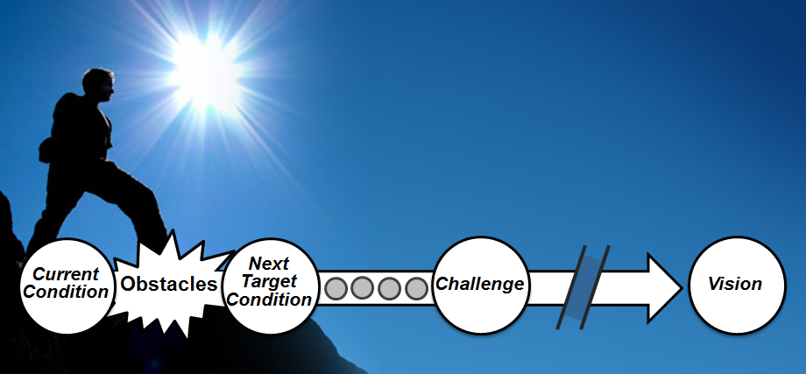
Improvement Kata

Slide 25
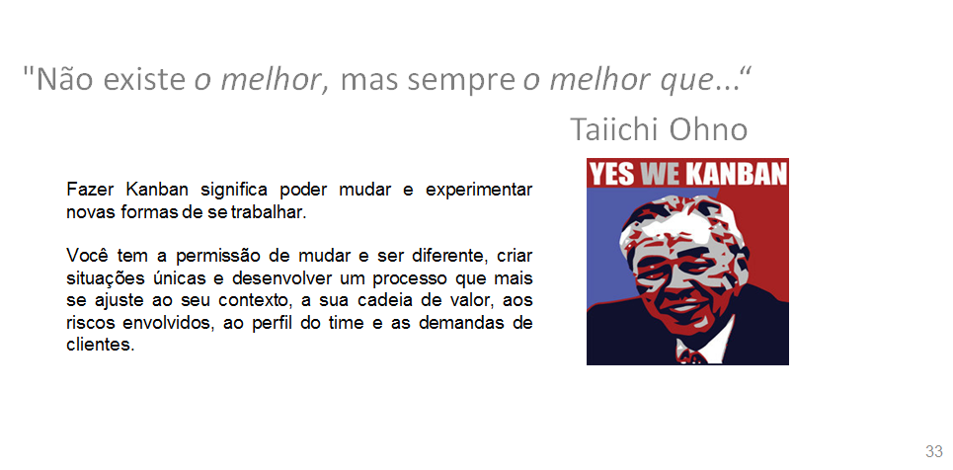
Kanban

Slide 26
Kanban Princípios e métricas

Slide 27
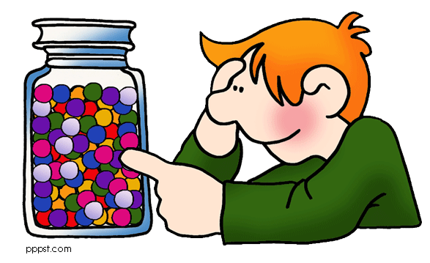
Dinâmica
Quanto tempo leva para escrever um nome?

Slide 28
O que poderia afetar a estimativa?

Slide 29


Papéis
Meu nome é...
Escrever o nome
dos Clientes
Desenvolvedor
Clientes

Slide 30
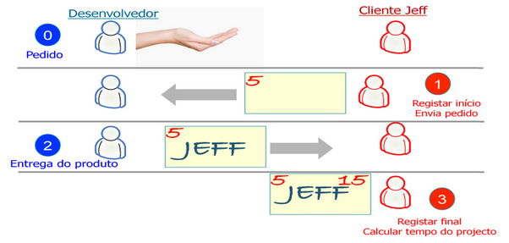
Processo

Slide 31
1ª Rodada
A política da empresa é:
“Quanto mais cedo começarmos, mais cedo acabaremos.”
Nunca deixe um cliente à espera, porque é um mau negócio
Nós podemos perder o cliente que estiver à espera

Slide 32
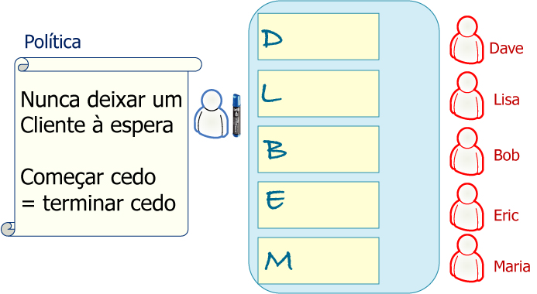
1ª Rodada

Slide 33
2ª Rodada
A política da nova empresa é:
“Pare de começar e comece a terminar”
Limitar o trabalho em andamento
Focar em apenas um cliente por vez

Slide 34
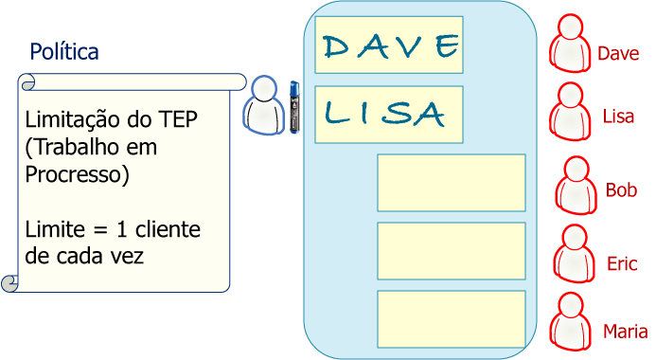
2ª Rodada

Slide 35

Discussão

Slide 36
Lean

Slide 37
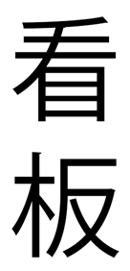
Princípios fundamentais

Slide 38
Princípios fundamentais
Visualização do workflow (kanban)

Slide 39
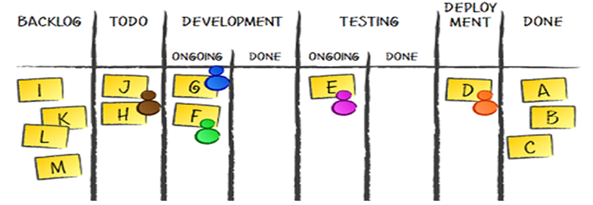

Slide 40
Princípios fundamentais
Visualização do workflow (kanban)
Políticas explicitas

Slide 41
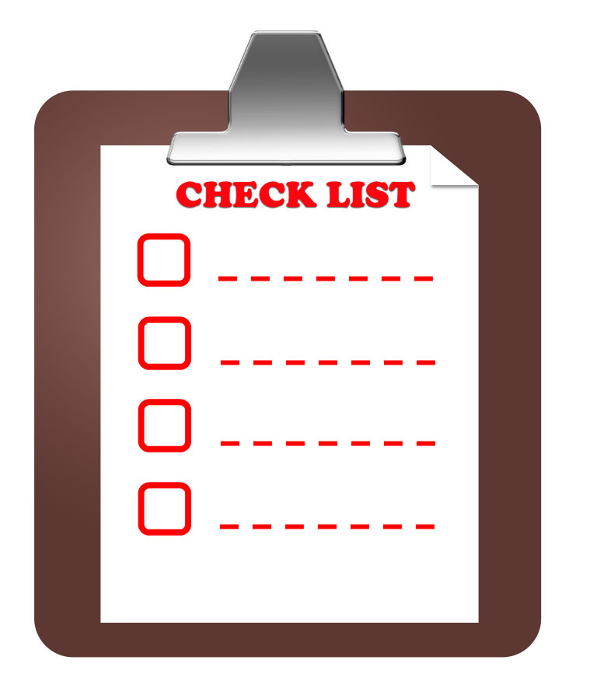

Slide 42
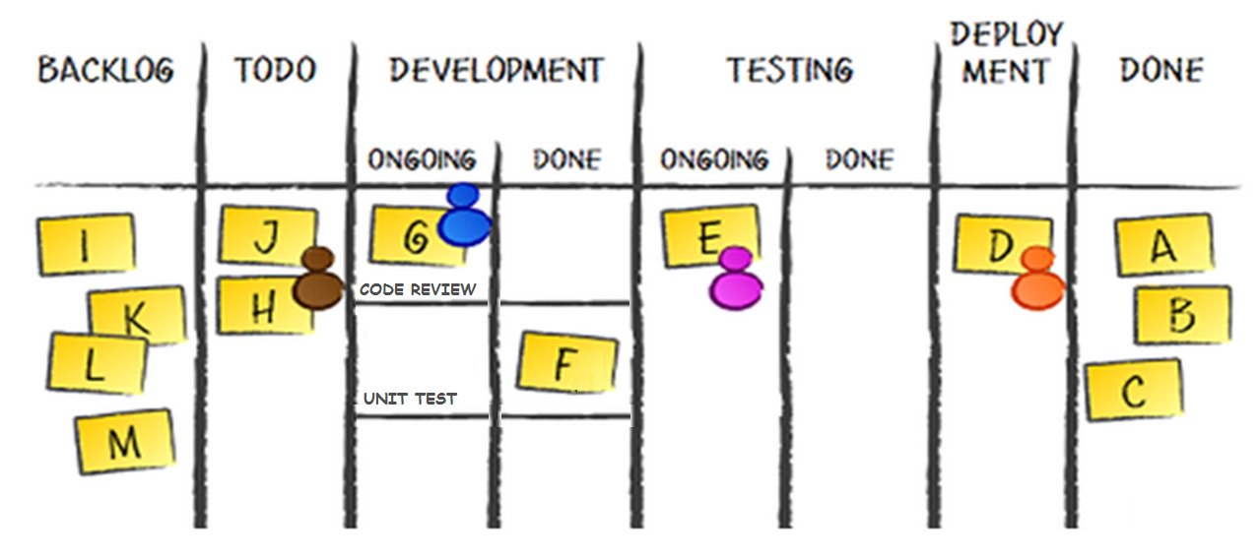

Slide 43
Princípios fundamentais
Visualização do workflow (kanban)
Políticas explicitas
Limitar o WIP
Sistema puxado
Small batch
Cadência e Fluxo contínuo

Slide 45
Princípios fundamentais
Visualização do workflow (kanban)
Políticas explicitas
Limitar o WIP
Sistema puxado
Small batch
Cadência e Fluxo contínuo

Slide 46
Princípios fundamentais
Visualização do workflow (kanban)
Políticas explicitas
Limitar o WIP
Sistema puxado
Small batch
Cadência e Fluxo contínuo
Medir e Otimizar

Slide 47
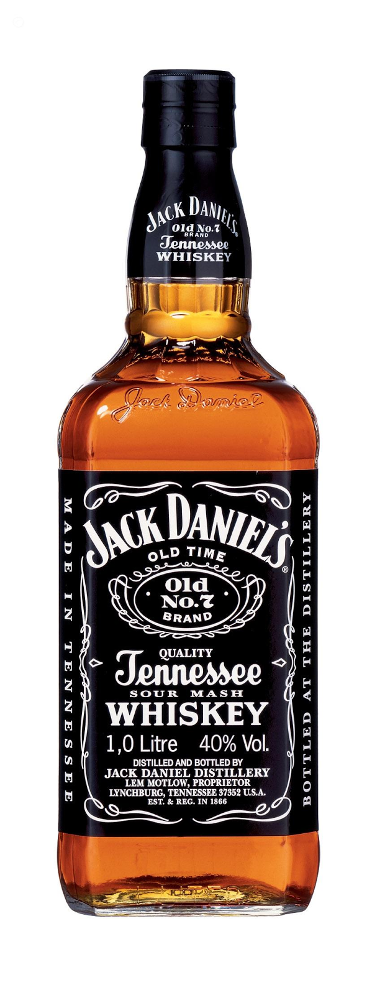
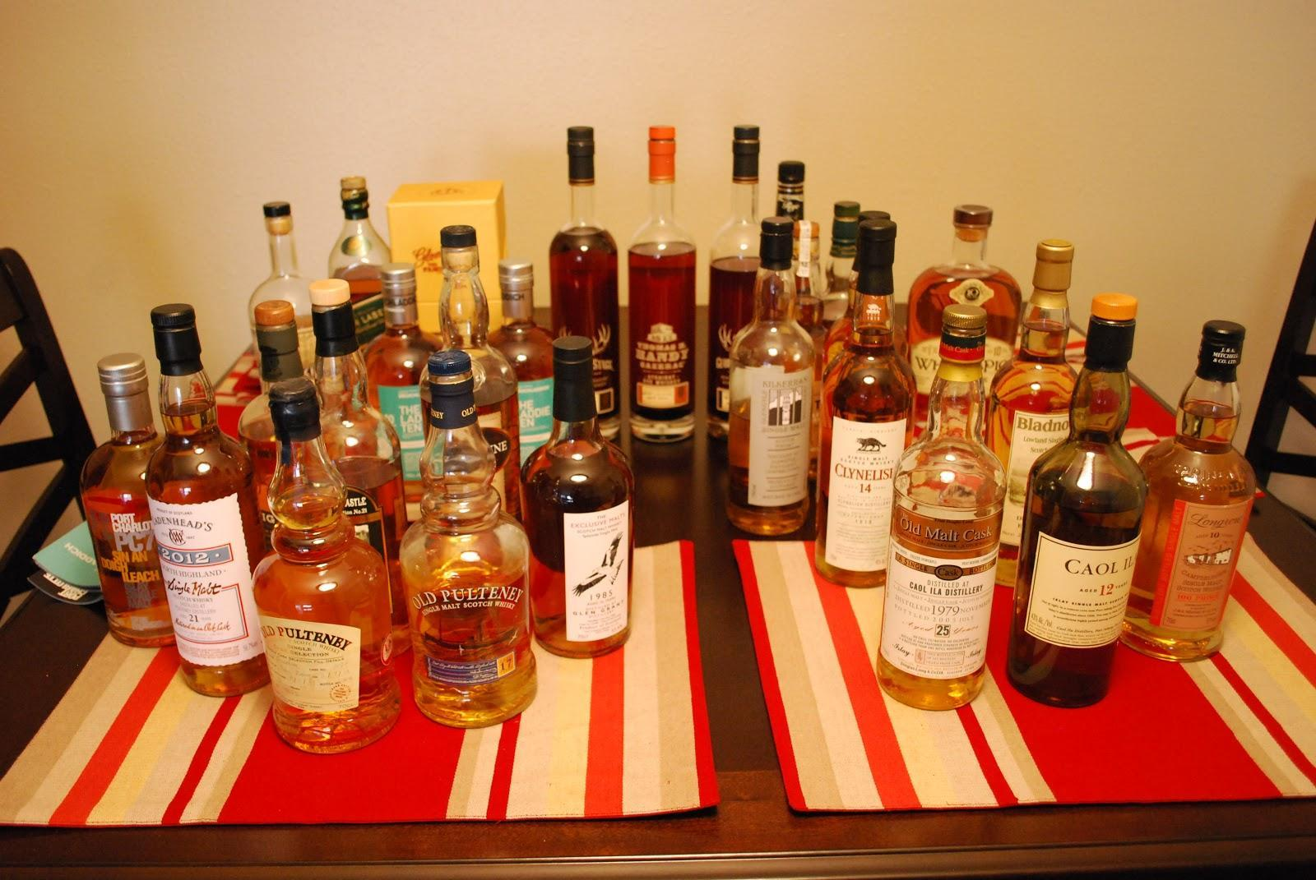
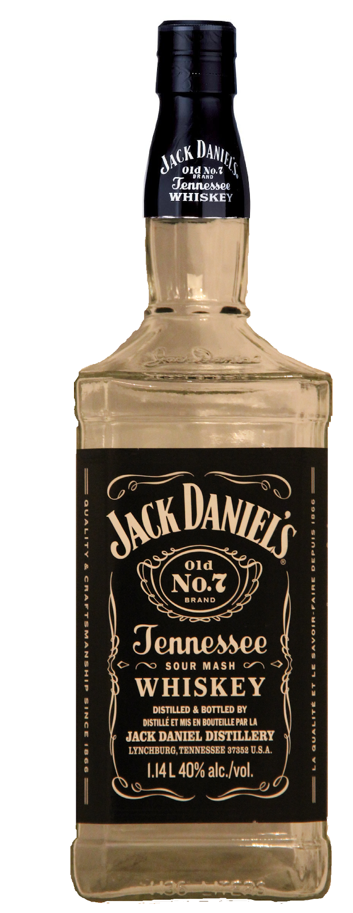
Lead Time de uma garrafa
Quanto tempo demoro para tomar uma garrafa inteira?
A cada 2 meses eu termino uma garrafa
12 Garrafas de Whisky
12 garrafas

Slide 48
Métricas do processo Kanban
LeadTime = WIP
CycleTime = 1
Reduzir tarefas
em andamento
Throughput
Melhoria dos processos
Eliminando desperdícios
Eliminando gargalos
Contratações
Throughput

Slide 49
Métricas do processo Kanban
Épico = LeadTime + (n-1).CycleTime
Onde:
n = número de histórias do épico

Slide 50
Dinâmica
Small batch e Fluxo contínuo

Slide 51
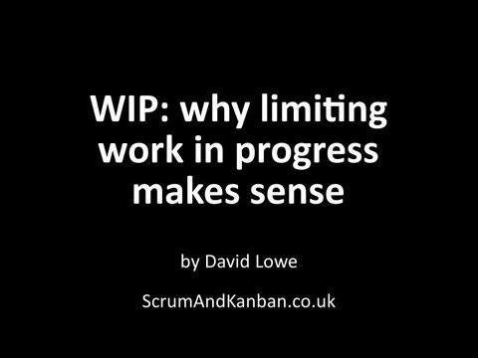

Slide 52
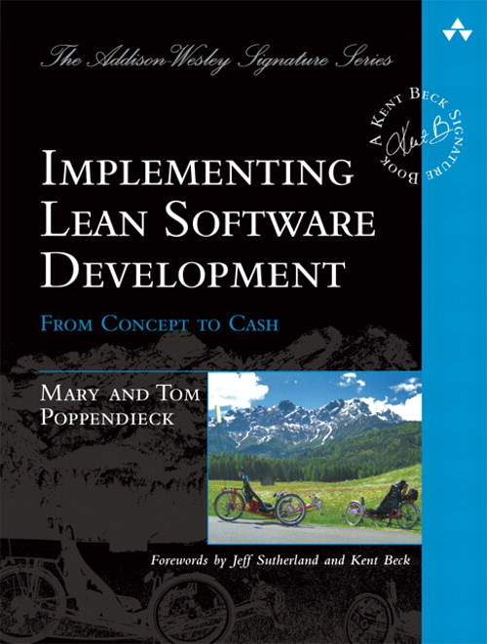
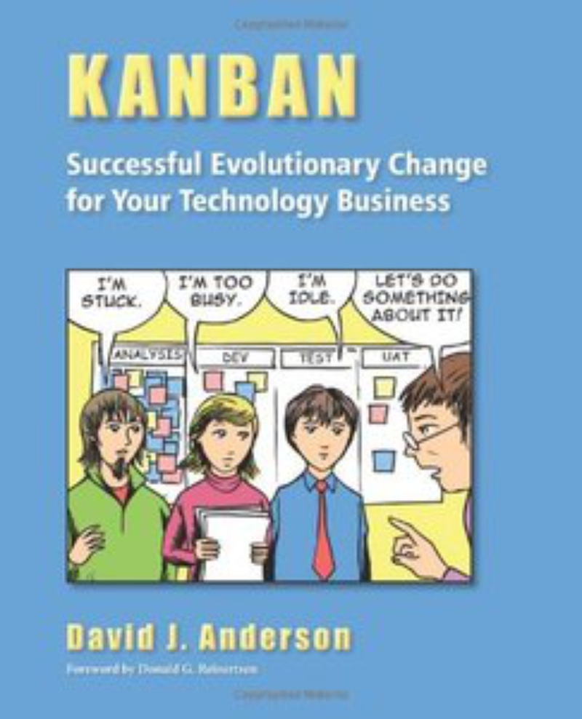
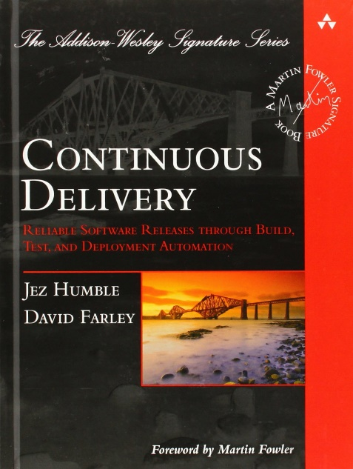
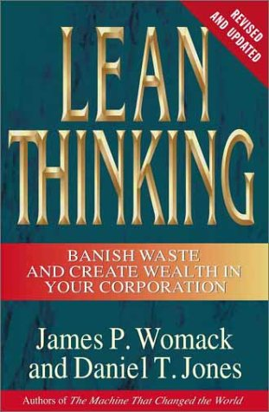
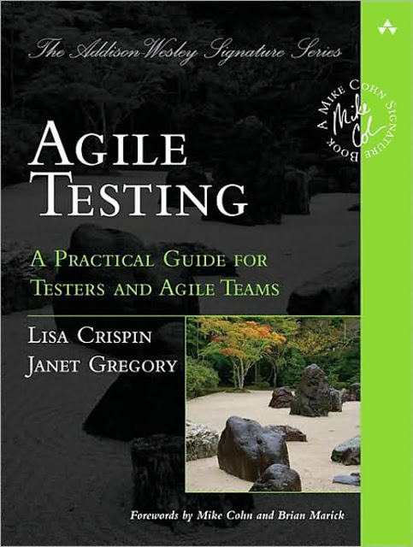
Bibliografia

Slide 53
Kaizen

Slide 54



VIDEO 1: Working Iteratively
(3 minutes)
https://www.youtube.com/watch?v=COKqiFaHm1s
Also available on the IK/CK YouTube Channel

Slide 55
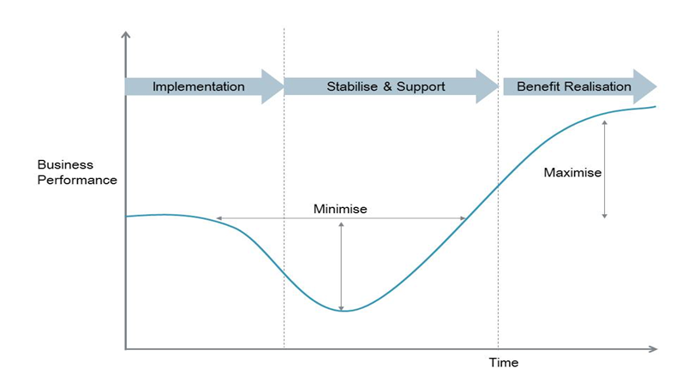
Curva de mudanças
CAOS

Slide 56
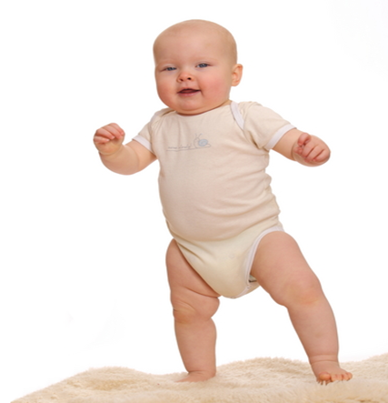
Baby Steps

Slide 57
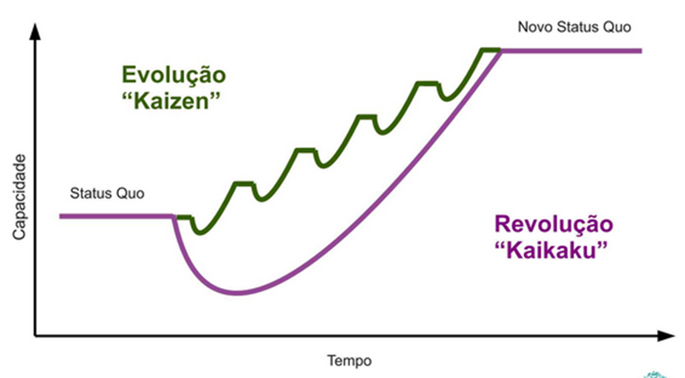
Kaizen

Slide 58
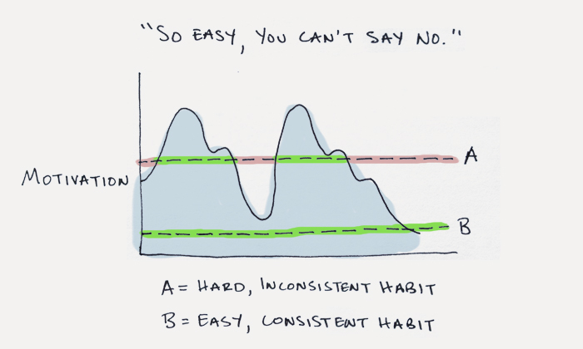
Kaizen

Slide 59
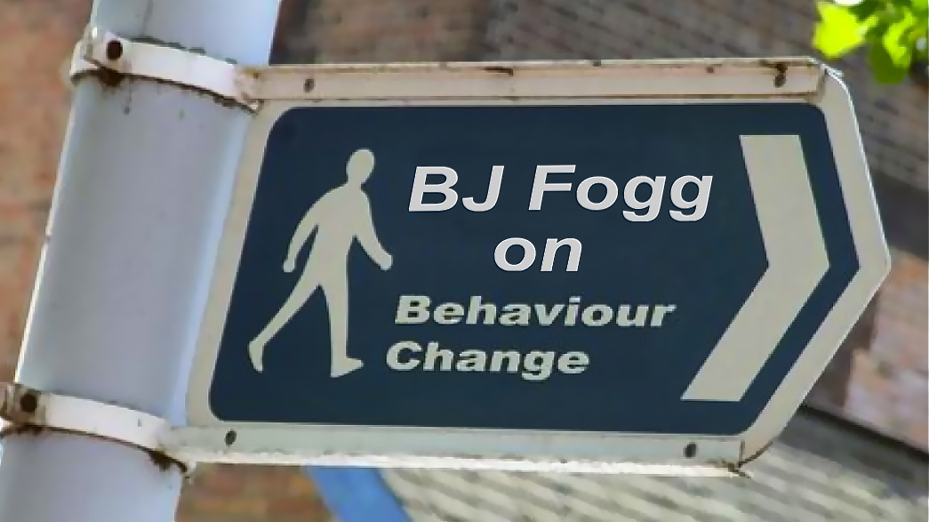
VIDEO 2:
Practicing in Small Steps
(4 minutes)
https://www.youtube.com/watch?v=cfAQ8oJIGoA
Also available on the IK/CK YouTube Channel

Slide 60
Improvement kata

Slide 61





DOWNLOAD
KATA
POWERPOINT SLIDES
Includes
Videos
Includes IK Card
For creating your own KATA presentations and training
http://www-personal.umich.edu/~mrother/The_Improvement_Kata.html

Slide 62
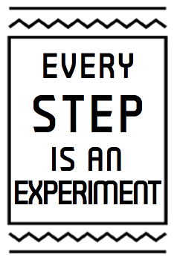
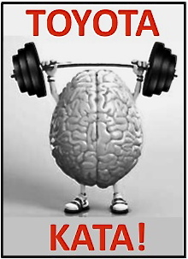

Slide 63
THE SCIENTIFIC LEARNING CYCLE
Is sometimes called
"Plan-Do-Check-Act" or "Plan-Do-Study-Act"
EVALUATE
Adjust based on what you learn
PREDICTION
Testable
ACT
PLAN
4
1
3
2
CHECK
(Study)
DO
EVIDENCE
Collect facts and data
ACTION
Conduct the
experiment

Slide 64




THE FOUR STEPS OF THE IMPROVEMENT KATA MODEL
A systematic, scientific pattern of working
1
2
3
4
Understand
the Direction
or Challenge
Grasp the
Current
Condition
Establish the
Next Target
Condition
Iterate
Toward the Target Condition
TC
CC
Planning
Phase
Executing
Phase
The Improvement Kata model comes from six years
of research into how Toyota manages people,
which is summarized in the book “Toyota Kata”

Slide 65

THE FOUR STEPS OF THE IMPROVEMENT KATA MODEL
A systematic, scientific pattern of working
1
2
3
4
Understand
the Direction
or Challenge
Grasp the
Current
Condition
Establish the
Next Target
Condition
Iterate
Toward the Target Condition
TC
CC
Planning
Phase
Executing
Phase
The Improvement Kata combines a scientific pattern with techniques of deliberate practice to develop problem solving skill

Slide 66

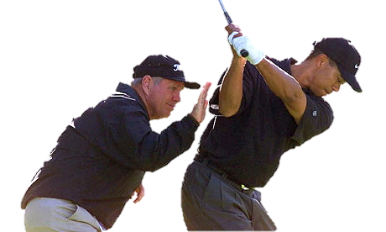
PRACTICING FOUNDATIONAL SKILLS
FOR SCIENTIFIC THINKING
Visible
Lean tools and techniques to improve quality, cost and delivery
A systematic, scientific way of thinking and acting
Managers as the teachers of that way
Less
Visible
What we're focusing on

Slide 67


THE IK & CK GIVE YOU AN EASY WAY
TO PRACTICE SCIENTIFIC THINKING
Scientific thinking is a basis for:
Successfully pursuing seemingly unattainable goals in complex systems
Enabling teams to make decisions close to the action and maneuver effectively
Science + Kata = Problem Solving Skill
The Improvement Kata & Coaching Kata make scientific thinking a skill anyone can learn, by combining a 4-Step scientific pattern + simple, structured routines for practicing the pattern.

Slide 68
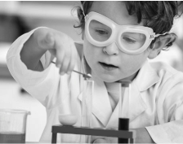
SCIENTIFIC
THINKING
"Let's try it and see"
Scientific thinking is a routine of intentional coordination between what we think will happen (theory), what actually happens (evidence), and learning from the difference.
What we
expect
to happen
What
actually
happened
Learning

Slide 69
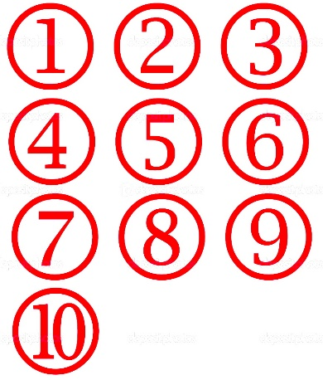
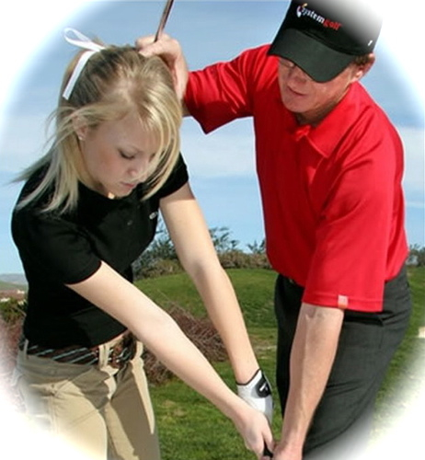



5 INGREDIENTS FOR ACQUIRING NEW SKILLS
Brain research is clear: To develop new habits you should practice new routines and experience a progressive sense of mastering them (which helps generate and maintain enthusiasm). The following ingredients help us rewire our brain to acquire new skills and mindset.
PRACTICE
Daily
KATA
Structured practice
routines (beginner)
COACHING
Corrective
feedback
This is how you do it
CHALLENGE
A desired new state
MASTERY
Overcoming
obstacles

Slide 70
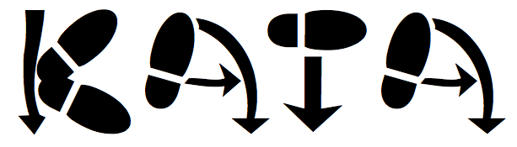
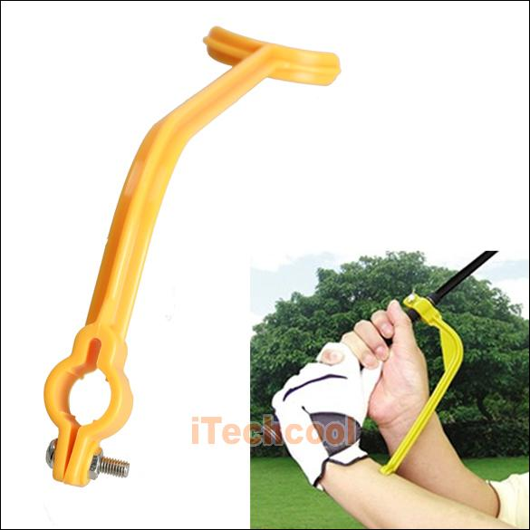
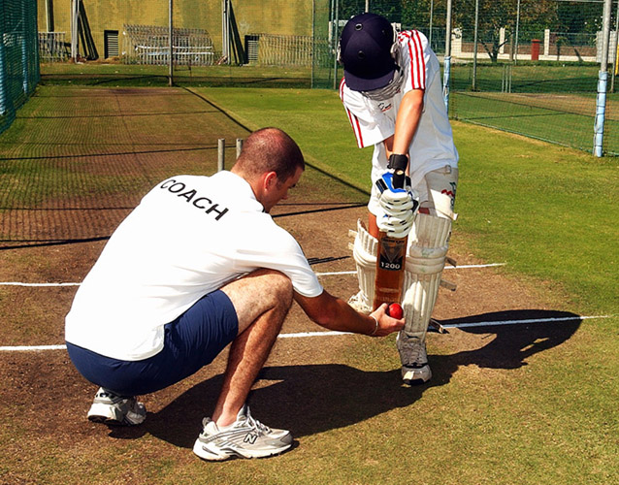
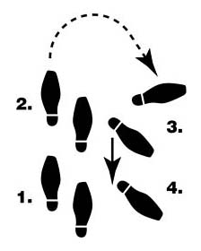
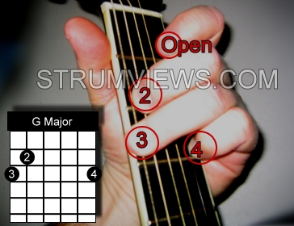
Example of a Kata
“Let’s begin by practicing it this way for a while.”

Slide 71

VIDEO 3:
What We Know About How People Learn
(2 minutes)
https://www.youtube.com/watch?v=ELpfYCZa87g
Also available on the IK/CK YouTube Channel

Slide 72
STAGES OF KATA PRACTICE
Real life doesn't pass through such discrete stages,
but they are a useful way to depict the progression
(1) FOLLOW: Start by repeating each practice routine without modification, so you can absorb its fundamental pattern. This
can take 1-2 months. Concentrate on how to do the task without worrying too much about the underlying theory.
(2) DETACH: Once you've internalized the basic patterns you can branch out. As the patterns get more habitual and you understand the 'why' behind them, you'll start to adapt them.
(3) FLUENCY: At this stage your actions become natural. You don't have to think consciously about basics anymore, which makes you smoother, quicker and frees brain capacity for handling situational inputs. At this stage you'll create your own approaches and readily fit what you've learned to many different circumstances, while sticking to basic underlying principles.

Slide 73
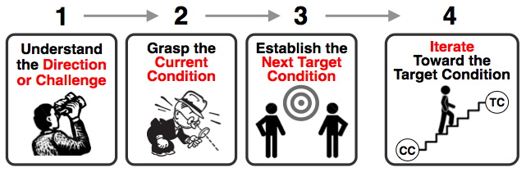

THE
IMPROVEMENT KATA
The Improvement Kata is a model of the human creative process. It’s a 4-step pattern of establishing target conditions and then working iteratively (scientifically) through obstacles, by learning from them and adapting based on what's being learned.
THE COACHING KATA
The Coaching Kata is a pattern for managers to follow in teaching the Improvement Kata pattern in daily work, so that it becomes part of an organization's culture.

Slide 74






WHAT IS FUNDAMENTAL / CHANGEABLE?
The IK
Pattern
The behavior model
Don't
change
this
BASIC
PRINCIPLE
The IK
Practice Routines
For the Learner
PRACTICE
THESE
Then adapt them to suit your organization
The Coaching Kata Routines
For the Coach
PRACTICE
THESE
Then adapt them to suit your organization

Slide 75
QUICK DEFINITIONS
The Improvement Kata: Scientific steps for achieving challenging goals.
The Improvement Kata is a teachable four-step model of the scientific way of thinking & acting.
The Improvement Kata is a set of practice routines for learning to work scientifically when you pursue goals in complex systems.
The Coaching Kata: Teaching Improvement Kata skill for achieving challenging goals.
The Coaching Kata is a practice routine for how to teach the Improvement Kata pattern.
The Coaching Kata is a pattern for teaching the Improvement Kata.

Slide 76






Roles / Org Structure for Practicing
Team
Learner's
Storyboard
2nd Coach
Coach
(Manager)
Learner
Coaches
the Coach
Practices the
Coaching Kata
Practices the
Improvement Kata

Slide 77


There is a
LEARNING PROGRESSION
Able to TEACH it
Able to DO it
AWARE of it
Sorry, no
way around it

Slide 78

THE IMPROVEMENT KATA PATTERN
A systematic, scientific way of working
Current
Condition
Next
Target
Condition
Obstacles
Challenge
Vision

Slide 79

THE IMPROVEMENT KATA
+ THE COACHING KATA
It’s a methodology for developing people
to meet challenges
Understand the Direction or Challenge
Grasp the Current Condition
Establish the Next Target Condition
Iterate
Toward the Target Condition
Improvement
Kata
Learner
‘Executing’
Coaching Cycles
Coaching
Kata
‘Planning’ Coaching Cycles
Coach
(Manager)

Slide 80
CONNECTING STRATEGY & EXECUTION
The role of Challenge in an organization
Managers develop people by coaching application practice of the Improvement Kata in the direction of the challenge
Leaders establish the organizationʼs strategic concept (the “rallying point” or overall direction)
Current
Condition
Next
Target
Condition
Obstacles
Challenge
Vision
Execution
Strategy

Slide 81



PRACTICING WORKING SCIENTIFICALLY
STEP 1
The
Direction
or Challenge
Next
Target
Condition
(dated)
Obstacles
Threshold of Knowledge
Experiments
Current
Condition

Slide 82
PRACTICING WORKING SCIENTIFICALLY
STEP 2
The
Direction
or Challenge
Next
Target
Condition
(dated)
Obstacles
Threshold of Knowledge
Experiments
Current
Condition

Slide 83
PRACTICING WORKING SCIENTIFICALLY
STEP 3
The
Direction
or Challenge
Next
Target
Condition
(dated)
Obstacles
Threshold of Knowledge
Experiments
Current
Condition

Slide 84

PRACTICING WORKING SCIENTIFICALLY
STEP 4
The
Direction
or Challenge
Next
Target
Condition
(dated)
Obstacles
Threshold of Knowledge
Experiments
Current
Condition

Slide 85
TERMINOLOGY
The
Direction
or Challenge
Next
Target
Condition
(dated)
Obstacles
Threshold of Knowledge
Experiments
Current
Condition

Slide 86

WHAT IT REALLY LOOKS LIKE
Challenge
Next
Target
Condition
(date)
Threshold of Knowledge
Experiments
At the current
Knowledge Threshold
Current
Condition

Slide 87

WHAT IT REALLY LOOKS LIKE
Challenge
Next
Target
Condition
(date)
Threshold of Knowledge
Experiments
At the Current
Knowledge Threshold
Current
Condition

Slide 88

THERE'S A THRESHOLD OF KNOWLEDGE
BETWEEN YOU AND YOUR GOAL
It's the point at which you have no facts or data
and start guessing
Where
you
are
Limit of what you currently know
The
Goal
Path isn't knowable in advance
Complexity
Obstacles
?
?
Next
Target
Condition
(date)
?
Unclear
Territory
Your Current
Knowledge
Threshold
Where you
want to be
next

Slide 89

THE IK PATTERN IS USED AT ALL LEVELS
The content is different, but the pattern of thinking is the same
Understand
the Direction
or Challenge
(from level above)
Iterate Toward the Target Condition
Grasp the
Current
Condition
Establish the Next Target Condition
Organization
Level
(Organization’s vision and strategic objectives)
Value Stream
Level
Value Stream
Loop Level
Process
Level
PLANNING
EXECUTING

Slide 90
THE IK PATTERN CONNECTS THE LEVELS
A Target Condition at one level is the Direction for the next level
Understand
the Direction
or Challenge
(from level above)
Iterate Toward the Target Condition
Coach/Learner
relationships
Grasp the
Current
Condition
Establish the Next Target Condition
Organization
Level
Longer-Cycle Experiments
Value Stream
Level
Current State Value Stream Mapping
Future State Value Stream Mapping
Value Stream
Loop Level
Process
Level
Short-Cycle Experiments
PLANNING
EXECUTING

Slide 91

THE ROLE OF
VALUE STREAM MAPPING
Target
Condition
Next
Target
Condition
Typically a
6-month
to 3-year
time frame
Process Team A
Target
Condition
Next
Target
Condition
Process Team B
Challenge
Vision
Target
Condition
Next
Target
Condition
Process Team C
Typically a
1-week
to 2-month
time frame

Slide 92

WHAT IS “DELIBERATE PRACTICE”?
Itʼs practice designed specifically to improve performance over time.
Itʼs practice that involves continual evaluation of your weaknesses and targeting specific weaknesses, rather than repeatedly doing what you already know how to do.
Itʼs practice that requires a coach. Observation and specific feedback on your current performance is critical to understanding what to work on and acquiring new skill.
Itʼs practice where you donʼt move on to the next part of the routine youʼre trying to learn until you master the part youʼre currently working on.

Slide 93

A FEW SKILL-DEVELOPMENT BASICS
Any complex performance requires skill.
We develop new skill through practice.
Long time-gaps between practice sessions diminishes the effectiveness of practice. Daily often seems to be a good frequency.
We are not good at self-feedback to understand where we are deviating from good practice and need corrective action.

Slide 94

The Learner's Storyboard
Start with this format

Slide 95
Focus Process:
Challenge:
Target Condition
Achieve by:
Current Condition
PDCA Cycles Record
Obstacles Parking Lot

Slide 96


Card is downloadable at:
http://www-personal.umich.edu/~mrother/KATA_Files/5Q_Card.pdf

Slide 97
PDCA CYCLES RECORD
(Each row = one experiment)
Obstacle:
Process:
Learner:
Coach:
Date, step & metric
What do we expect?
What happened
What we learned
Do a Coaching Cycle
Conduct the Experiment

Slide 98


The Five Coaching Kata Questions and
the PDCA Cycles Record are used together
5-Question Coaching Dialog
Rapid PDCA Cycles
Used by the Coach
Used by the Learner

Slide 99
ASK THE FIVE QUESTIONS AT EACH STEP

Slide 100
Obrigado!

